Slide 1
Real-Time Distributed Algorithms
David Kozhaya
ABB Corporate Research Switzerland

Slide 2
Distributed Systems
Why do we need them?
Examples of Applications
Gains
Better Performance
More Storage
Higher Resilience
e-commerce
Pains
Social media
Your problem is no longer your problem alone
Blockchains
Notes:
Distributed systems comprise multiple software and hardware components that are bound to eventually fail. Such failures can cause service malfunction or unavailability, incurring signiﬁcant costs to mission-critical systems, e.g., automation systems and on-line transactions. The failures’ impact can be minimized by protocols that let systems agree on actions despite failures.
As a consequence, many variants of the agreement or the consensus problem under diﬀerent assumptions have been studied mainly .

Slide 3
ABB Products
These are only a tiny part of our product portfolio

Slide 4
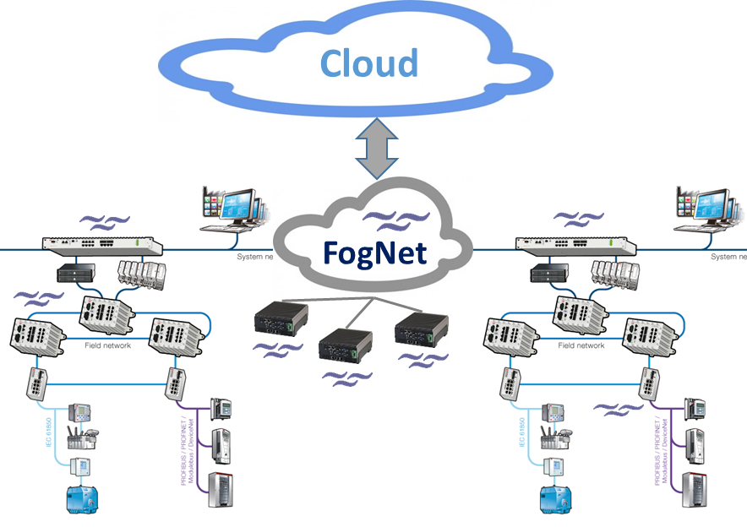
Importance of Distributed Systems to ABB
Distributed Systems Projects at ABB
Distributed Control Systems
Auxiliary Control Applications
ABB Cloud Platform & Analytics
Operator stations
servers
Fog
controllers
Field devices
Smart Cities
Collaborative Robots
ABB Service Smart Contracts

Slide 5
Distributed Systems
Industrial vs. Traditional
How are they different?

Slide 6
Traditional Distributed Systems
Solution approach
Distributed Abstractions
Abstraction
1
Define problem as an abstraction
2
3
Safety Properties
Distributed Problem
Liveness Properties
No duplication
No creation
Agreement
Reliable Broadcast
Validity

Slide 7
Traditional Distributed Systems
The modular solution approach
Distributed Abstractions
No duplication
No creation
Agreement
1
Define problem as an abstraction
2
Implement abstraction in a system model
3
Validity
Reliable Broadcast Abstraction (RB)
Algorithms to implement RB in
Synchronous
Partially Sync
Asynchronous

Slide 8
Traditional Distributed Systems
Solution approach
Distributed Abstractions
1
Define problem as an abstraction
2
Implement abstraction in a system model
3
Use abstraction as building block
Algorithms to implement consensus
Reliable Broadcast
Reliable Broadcast
Reliable Broadcast
Synchronous
Partially Sync
Asynchronous
Never changing and/or never ending conditions

Slide 9
Cyber-physical Systems
Differences with Traditional Distributed Systems
Smart City: An Example of a Cyber-physical System
Differences in Abstractions
Energy Efficiency
Battery operated devices
Real-time behavior
Hard timing deadlines

Slide 10
Cyber-physical Systems
Differences with Traditional Distributed Systems
Smart City: An Example of a Cyber-physical System
Difference in System Models
fiber
Time varying quality of communication links
Links oscillate between synchrony and asynchrony phases
powerline
wireless

Slide 11
Probabilistically Synchronous Model
Processes:
Synchronous
Some can fail
Communication links:
A link is reliable but asynchronous
After some point in time (unknown) all links become synchronous forever

Slide 12
Broadcast Protocols
No duplication: No message is delivered more than once
No creation: If a process delivers message m with sender s, then s broadcast m
Agreement: if a correct process delivers m, then every correct process delivers m
Partially Synchronous System
with f<n
in
Validity: If a correct broadcasts m, then every correct process eventually delivers m
Reliable Broadcast Abstraction (RB)

Slide 13
Reliable Broadcast (RB)
Algorithm for Partially Synchronous System
@ process p
delivered={}
Upon event broadcast(m)
∀s ∈ ∏ :
send(p, m) to s;
Upon event deliver(q, m)
if (m ∉ delivered){
RB-deliver(m);
delivered=delivered U {m};
if(q!=p){
∀s ∈ ∏ :
send(p, m) to s;
}
}
RB-broadcast (m)
RB-deliver (m)
p
RB-deliver (m)
q
RB-deliver (m)
r
RB-deliver (m)
s
Notes:
Send broadcast and when deliverd when broadcast message is received

Slide 14
New System Model
Probabilistically Synchronous
Processes:
Synchronous
Some can fail
Communication links:
During any transmission, a link is reliable and synchronous (timely) with probability p

Slide 15
Broadcast Protocols
No duplication: No message is delivered more than once
No creation: If a process delivers message m with sender s, then s broadcast m
Agreement: if a correct process delivers m, then every correct process delivers m
Probabilistically Synchronous System
with f<n
in
Validity: If a correct broadcasts m, then every correct process eventually delivers m
Reliable Broadcast Abstraction (RB)

Slide 16
Reliable Broadcast (RB)
Algorithm for Probabilistically Synchronous System
@ process p
delivered={};
Upon event broadcast(m)
while (True){ wait (1 tu);
∀s ∈ ∏ :
send(p, m) to s;
}
Upon event deliver(q, m)
if (m ∉ delivered){
RB-deliver(m);
delivered=delivered U {m};
while(True){
if(q!=p){
∀s ∈ ∏ :
send(p, m) to s;
}
}
}
RB-broadcast (m)
RB-deliver (m)
p
RB-deliver (m)
q
RB-deliver (m)
r
RB-deliver (m)
s
Network is congested!
Notes:
Send broadcast and when deliverd when broadcast message is received

Slide 17
Broadcast Protocols
No duplication: No message is delivered more than once
No creation: If a process delivers message m with sender s, then s broadcast m
Agreement: if a correct process delivers m, then every correct process delivers m
Probabilistically Synchronous System with f<n
in
Validity: If a correct broadcasts m, then every correct process eventually delivers m
+
P
Reliable Broadcast Abstraction (RB)

Slide 18
Reliable Broadcast (RB)
Algorithm for Probabilistically Synchronous System with P
@ process p
delivered={}; acks={}; correct = ∏;
Upon event broadcast(m)
while (acks!=correct){
∀s ∈ correct :
send(p, m) to s;
}
Upon event deliver(q, m) from sender a
acks=acks U {a}
if (m ∉ delivered){
RB-deliver(m);
delivered=delivered U {m};
while(acks!=correct){
if(q!=p){
∀s ∈ ∏ :
send(p, m) to s;
}
}
}
upon event crash(q)
correct = correct - {q};
RB-broadcast (m)
RB-deliver (m)
p
RB-deliver (m)
q
RB-deliver (m)
r
RB-deliver (m)
s
Notes:
Send broadcast and when deliverd when broadcast message is received

Slide 19
Cyber-physical Systems
Differences with Traditional Distributed Systems
Smart City: An Example of a Cyber-physical System
Differences in Abstractions
Energy Efficiency
Battery operated devices
Real-time behavior
Hard timing deadlines

Slide 20
Adding Timeliness
Real-time Reliable Broadcast
No duplication
No creation
Agreement
No duplication
No creation
Agreement
Timeliness
Validity
Validity
Reliable Broadcast Abstraction (RB)
Real-time Reliable Broadcast Abstraction (RTRB)

Slide 21
Broadcast Protocols
No duplication: No message is delivered more than once
No creation: If a process delivers message m with sender s, then s broadcast m
Agreement: If a correct process delivers m, then every correct process delivers m
Timeliness: If a correct process broadcasts m at time t, then any correct process that delivers m does so by t+ Δr
Probabilistically Synchronous System
in
+
P
Validity: If a correct broadcasts m, then every correct process eventually delivers m
Real-time Reliable Broadcast Abstraction (RTRB)

Slide 22
Real-time Reliable Broadcast (RTRB)
Algorithm for Probabilistically Synchronous System with P
p
q
Impossible
r
s
Notes:
Send broadcast and when deliverd when broadcast message is received

Slide 23
Real-time Reliable Broadcast (RTRB)
Algorithm for Probabilistically Synchronous System with P
For any predefined Δr
Timing Failures
p
q
r
s
Notes:
Send broadcast and when deliverd when broadcast message is received

Slide 24
Transforming Timing Failures into Process Failures
For any predefined Δr
p
Detect Timing Failures
Force affected process to crash
q
r
s
Notes:
Send broadcast and when deliverd when broadcast message is received

Slide 25
Failure Detector TP
+
P
Every process suffering more than “x” timing failures eventually crashes

Slide 26
Broadcast Protocols
No duplication: No message is delivered more than once
No creation: If a process delivers message m with sender s, then s broadcast m
Agreement: If a correct process delivers m, then every correct process delivers m
Timeliness: If a correct process broadcasts m at time t, then any correct process that delivers m does so by t+ Δr
Probabilistically Synchronous System
in
+
TP
Validity: If a correct broadcasts m, then every correct process eventually delivers m
Reliable Broadcast Abstraction (RB)

Slide 27
Real-time Reliable Broadcast (RB)
Algorithm for Probabilistically Synchronous System with P
@ process p
delivered={}; acks={}; correct = ∏;
Upon event broadcast(m)
while (acks!=correct){
∀s ∈ correct :
send(p, m) to s;
}
Upon event deliver(q, m) from sender a
acks=acks U {a}
if (m ∉ delivered){
RB-deliver(m);
delivered=delivered U {m};
while(acks!=correct){
if(q!=p){
∀s ∈ ∏ :
send(p, m) to s;
}
}
}
upon event crash(q)
correct = correct - {q};
RB-broadcast (m)
RB-deliver (m)
p
RB-deliver (m)
q
RB-deliver (m)
r
RB-deliver (m)
s
Notes:
Send broadcast and when deliverd when broadcast message is received

Slide 28
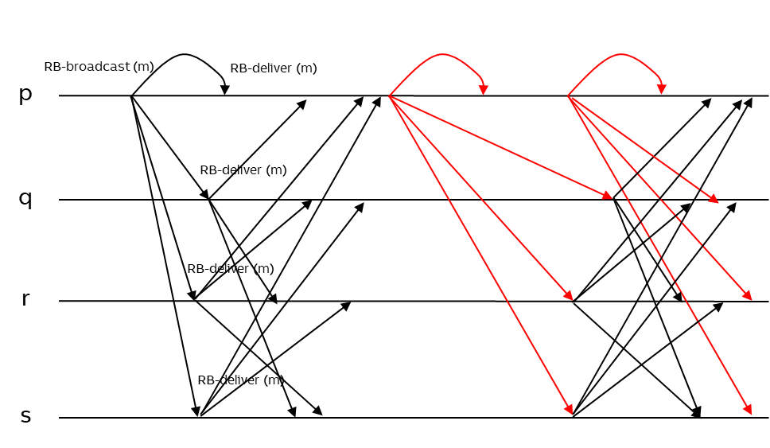
Modular Implementation
Broadcast Algorithm
p
TP Algorithm
q
r
s

Slide 29
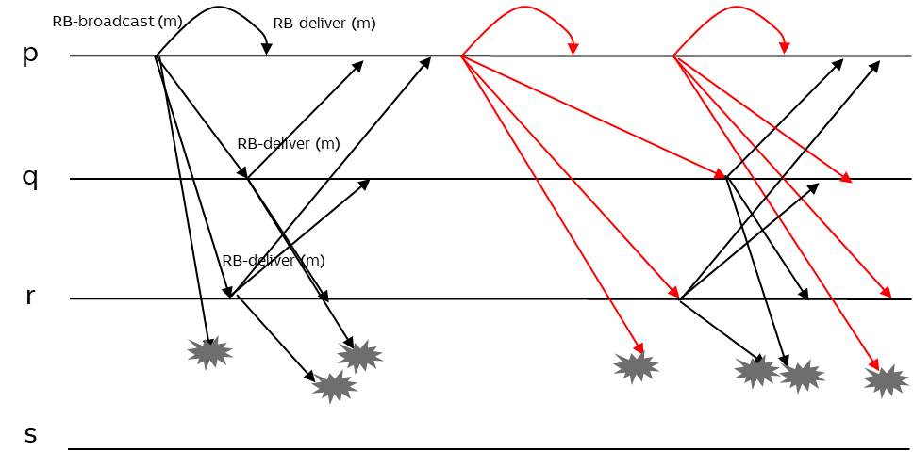
Modular Implementation
Broadcast Algorithm
Timing failures experienced
p
TP Algorithm
q
No timing failures experienced
r
s

Slide 30
Process Faults Vs Timing Faults
How are they different?
Process failures are system-wide
Timing failures are algorithm dependent

Slide 31
Conclusion
Notes:
Yippie, already at the end ☺
You’ve seen how we can describe distributed systems with lossy communication as well as permanent and transient failures
We devise a wrapper to use CS algorithms unchanged in real systems and for what class of algorithms the wrapper works.

